Slide 1





Efficient Simulation of Multimode Bosonic Systems: A Tensor Network and Monte Carlo based method
Jean-Baptiste Bertrand, Baptiste Royer
March 18th, 2024

Slide 2
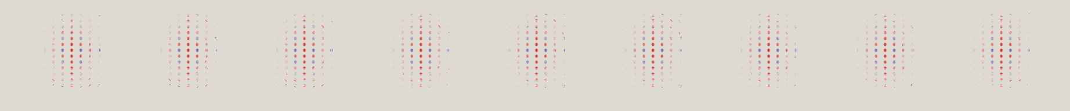
Goal: Simulate large quantum circuits where qubits are encoded in bosonic modes
CNOT
CNOT
CNOT
CNOT
CNOT
CNOT
CNOT
CNOT
CNOT
CNOT
H
H
H
H
H
H
H
H
H
H
H
H
H
H
H
H
H
1
Notes:
Simulating quantum system is hard :(, I want to simulate Bosonic qubits fast: I have many way do that!
Using Tensor networks is common to simulate quatum system but more so for simulating TLS qubits: I am using it to simulate

Slide 3

Tensor Networks allow you to represent systems in more efficient ways
Large quantum circuit/
Quantum computer
[1]Collura M et al. 2024 Tensor Network Techniques for Quantum Computation
[2]Berezutskii A et al. 2025 Tensor networks for quantum computing (arXiv)
[3]Orus R 2014 Annals of Physics 349 117
2
Notes:
Tensor networks are good at quantum because you can
Using Tensor networks is common to simulate quatum system but more so for simulating TLS qubits: I am using it to simulate bosonic qubits :)

Slide 4
Tensor Networks allow you to represent systems in more efficient ways
Low
Very fast
High
Very Accurate
[1]Collura M et al. 2024 Tensor Network Techniques for Quantum Computation
[2]Berezutskii A et al. 2025 Tensor networks for quantum computing (arXiv)
[3]Orus R 2014 Annals of Physics 349 117
3
Notes:
Tensor networks are good at quantum because you can
Using Tensor networks is common to simulate quatum system but more so for simulating TLS qubits: I am using it to simulate bosonic qubits :)

Slide 5
Low bond dimension should be required for bosonic circuits
Acts on logical subspace and should generate about as
much entanglement whether acting on cavities or TLSs
CNOT
Required dimension for
this link should be small
Each of these is a cavity that encode a qubit
4
Notes:
Tensor networks are good at quantum because you can
Using Tensor networks is common to simulate quatum system but more so for simulating TLS qubits: I am using it to simulate bosonic qubits :)

Slide 6
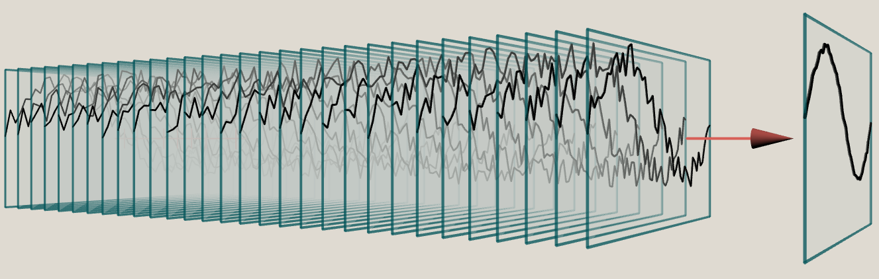
Monte Carlo: using vectors instead of density matrices
5
Notes:
In order to minimise even further the number of elements I have to keep track of, I use MC

Slide 7
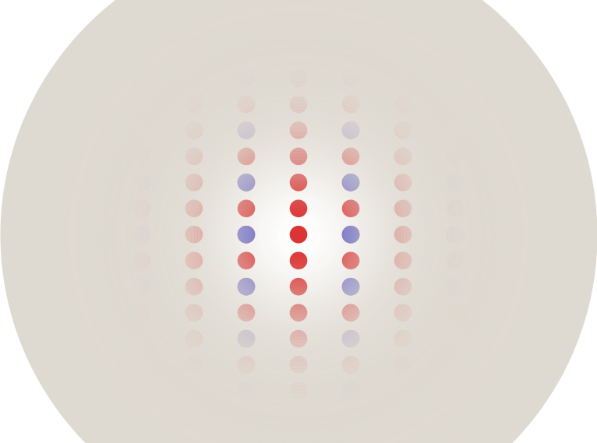


Using the right basis: Better intuition and better performances
sBs
GKP codespace
Defined from sBs
[1] Royer B, Singh S, Girvin S M 2020 Phys. Rev. Lett. 125 260509
[2] Hopfmueller F, Tremblay M, St–Jean P, Royer B, Lemonde M
6

Slide 8
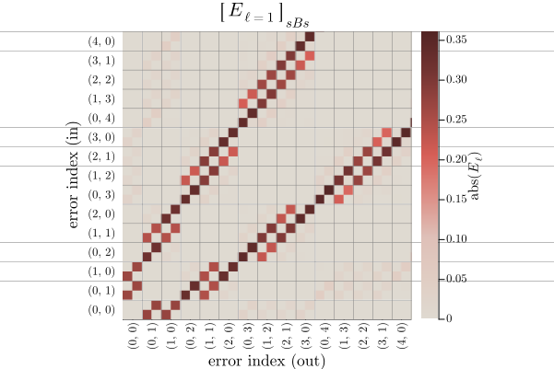
Using the right basis: Better intuition and better performances
Block structure in error space
Identity on logical
space
[1] Royer B, Singh S, Girvin S M 2020 Phys. Rev. Lett. 125 260509
[2] Hopfmueller F, Tremblay M, St–Jean P, Royer B, Lemonde M
7

Slide 9

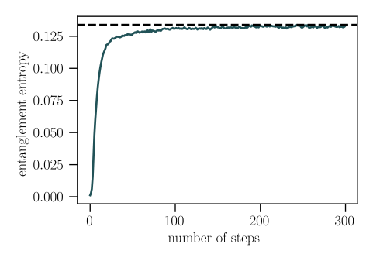
Single cavity: entanglement entropy between the logical and gauge space
logical space
error (gauge) space
8

Slide 10
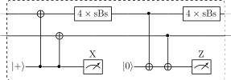

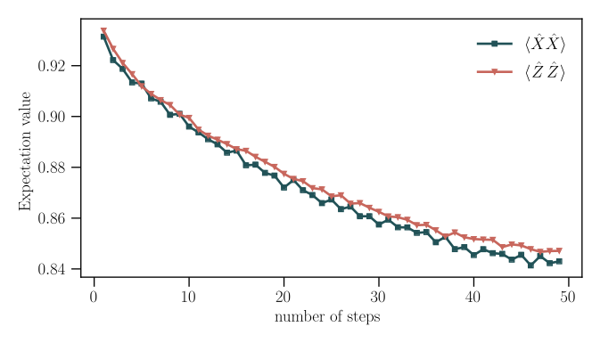
Results: Stabilizing a Bell Pair
GKP qubit
TLS qubit
9
Notes:
Look! A more complex system! There is a cavity and a qubit! :)

Slide 11
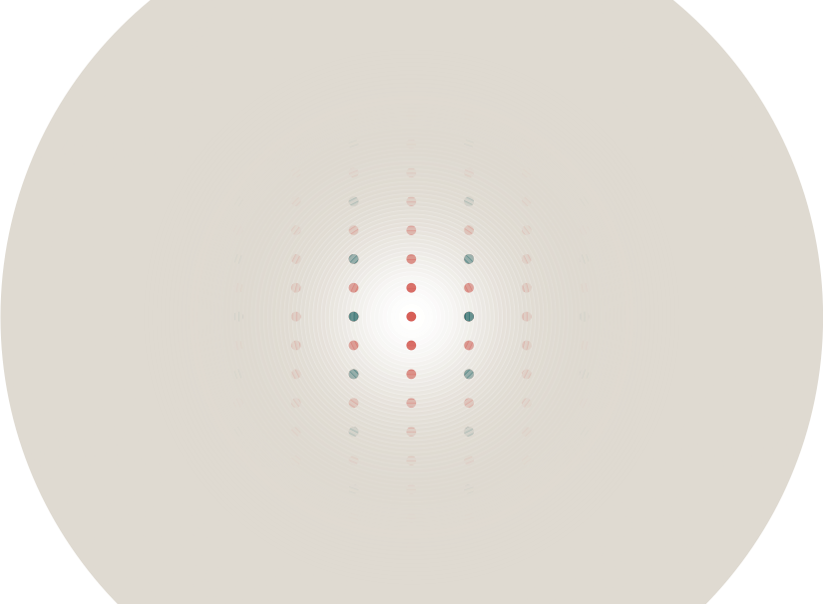
Summary
Simulating systems with many cavities can be hard because of a large hilbert space. Tools like tensor networks, Monte Carlo and clever basis choice can all be combined to get better performances.
Looking Forward
Simulating larger circuits
  Simulating code concatenation
The limits of the framework
  Accuracy of noise representation
  Exact effect of bond dimention
Different tensor network structures
10

